Slide 1
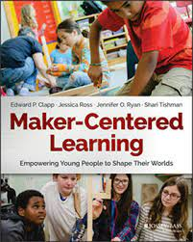
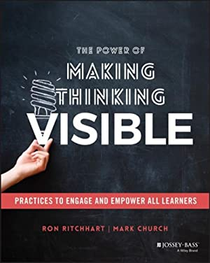
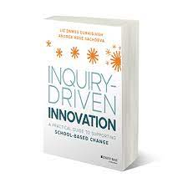
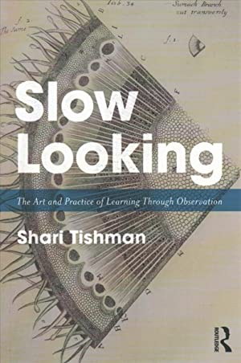
Intelligence
as multiple and learnable
Learning as
social and cultural
Understanding
as active and applied
Thinking and learning
as visible

Slide 2
We expect students to be autonomous and more reflective, but we don’t always explain to students how to develop greater autonomy or reflectiveness, do we? What are the steps? And now I realize that we can’t help students to be more autonomous if their teachers aren’t autonomous. So that’s a big problem. And what happens if we as the teachers’ coaches aren’t autonomous either?
Diana, coach, Innova Schools, Peru
A los estudiantes se les pide que sean más autónomos, que sean más reflexivos, pero a veces no se explica cómo hay que desarrollar no? ¿Cuáles son los pasos? Y ahora me di cuenta de que no podemos desarrollar autonomía en los estudiantes si los mismos maestros no son autónomos. Entonces ahí viene una gran dificultad. Y si los coaches tampoco no lo somos…
Diana, coach, Colegios Innova Schools, Peru

Slide 3
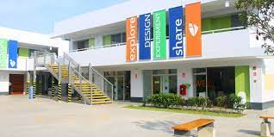
Collaborative inquiry-style PD with coaches and academic coordinators

Slide 4
Changes or developments in thinking and practice
Learning to be learners rather than experts possessing all the right answers
Attending to purpose rather than merely completing tasks
Embracing the new and uncertain rather than sticking closely to known plans
Developing trust–both in themselves and in other colleagues and students
Key challenges
Time
Competing priorities
Top-down culture
Experience and expertise
Trust issues
Creating spaces for collective observation, analysis and reflection
Modeling values and practices
Giving and receiving constructive feedback
Inquiry projects

Slide 5
I came to understand that living the experiences was how we were going to understand [autonomy] better … we worried less about what was right or wrong and tried things out, because we understood that whatever happened something good would come out of it.
Diana, coach, Innova Schools, Peru
Y hasta que comprendí que al vivir la experiencia es que nosotros ya íbamos a ir aprendiendo un poco más [la autonomía] … no nos preocupó mucho si era correcto o incorrecto, sino simplemente experimentar, porque entendimos que de todas maneras iban a salir cosas muy buenas de ahí. Diana, coach, Colegios Innova Schools, Peru

Slide 6
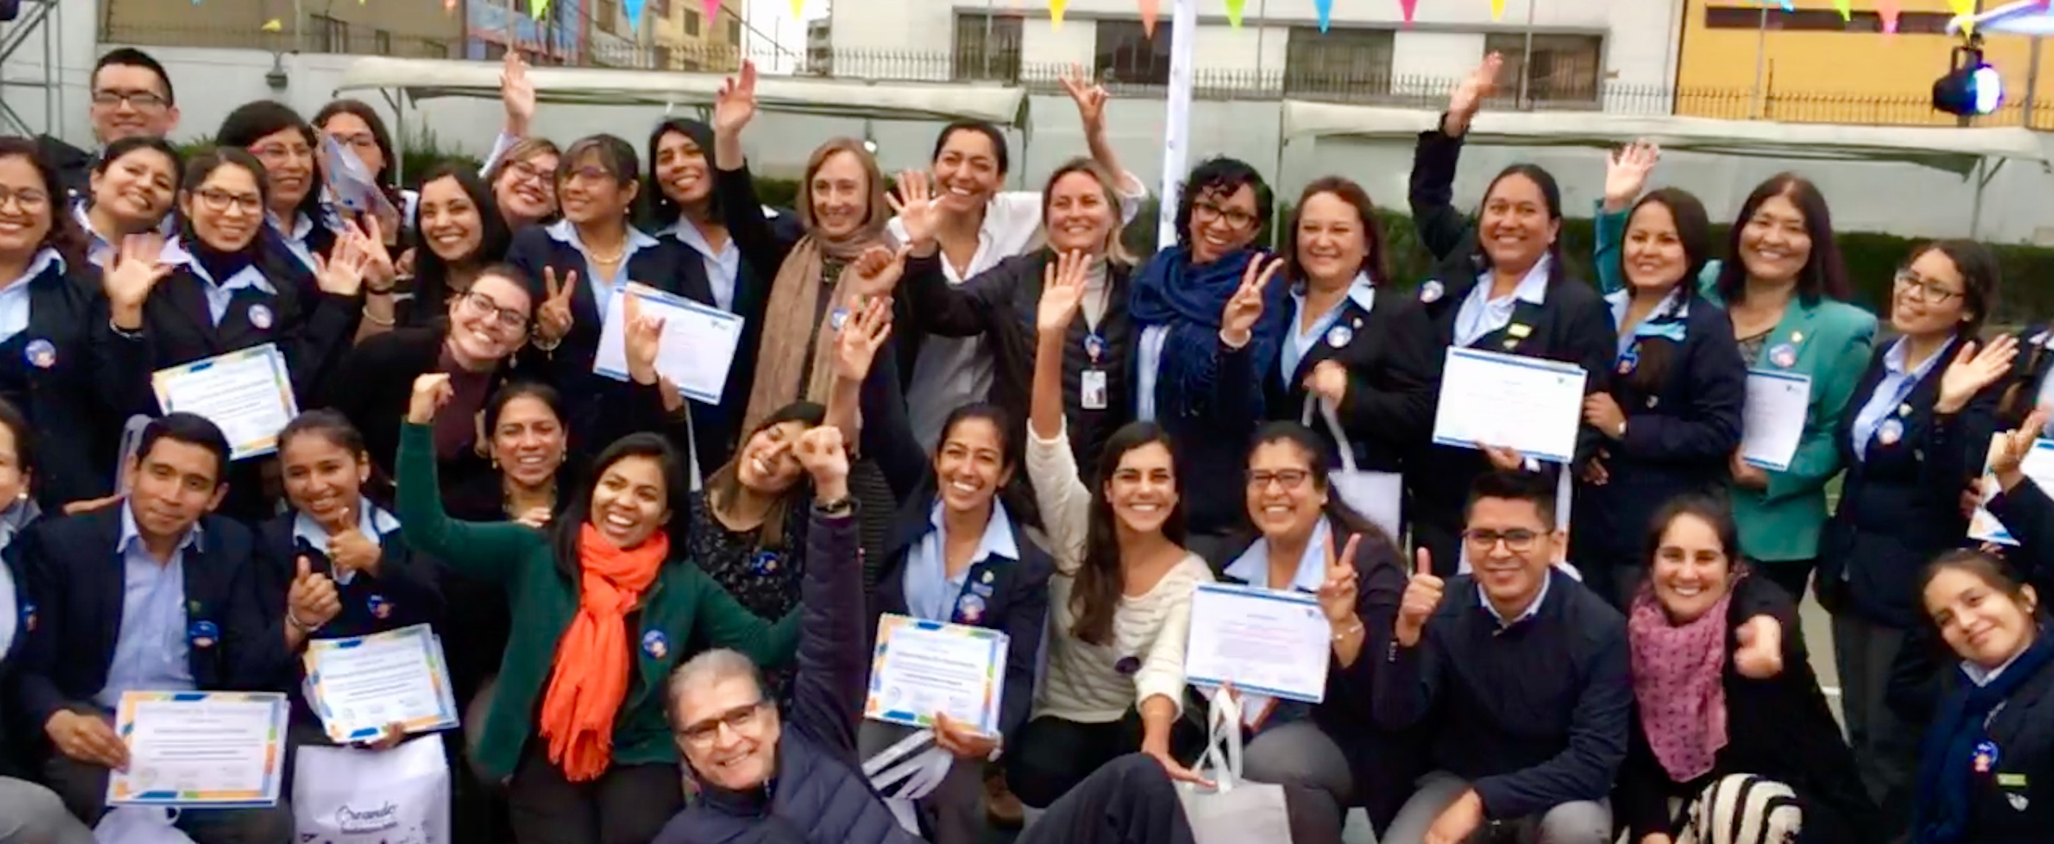
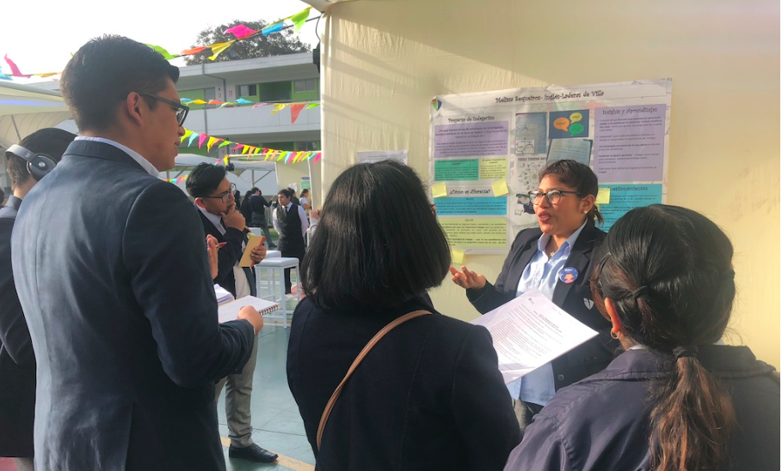
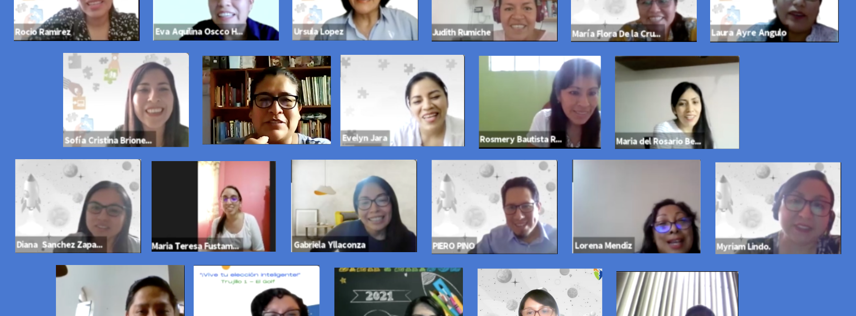

Slide 7
Be in touch if you would like to read our forthcoming white paper or are interested in a partnership that builds on this work!
elizabeth_duraisingh@harvard.edu

